Slide 1
Artificial Neural Network
FDP 2023 AN & ML (Day 5)
Dr. Uday Pratap Singh
Associate Professor
(AI & DS)
PIET, Jaipur

Slide 2
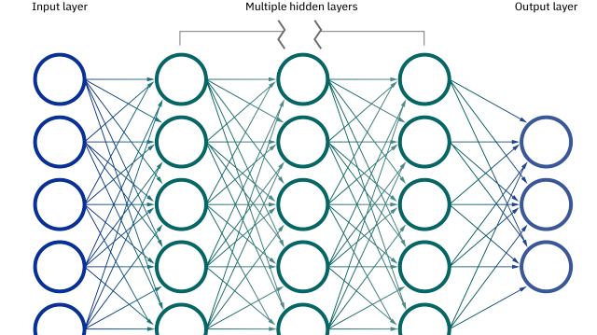
ANN
Neural networks, also known as artificial neural networks (ANNs) or simulated neural networks (SNNs), are a subset of machine learning and are at the heart of deep learning algorithms. Their name and structure are inspired by the human brain, mimicking the way that biological neurons signal to one another.

Slide 3
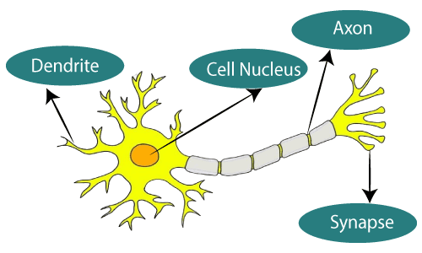
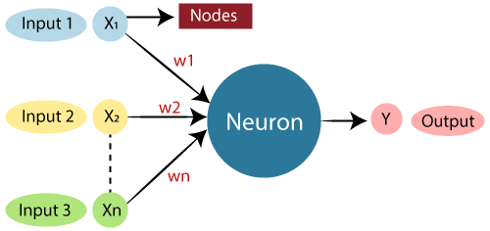
Biological Neuron vs ANN
Biological Neural Network | Artificial Neural Network
Dendrites | Inputs
Cell nucleus | Nodes
Synapse | Weights
Axon | Output

Slide 4
How do neural networks work?
The ANN acquires knowledge through the learning process by using learning algorithms and the acquired knowledge is stored using the interneuron connection strength, known as synaptic weights.
The ANN with the help of parallel distributed structure acquires its ability to learn and therefore generalize. Generalization means ANN produces reasonable outputs for new inputs ANN, which is not encountered during training. A model of neuron is shown in Fig

Slide 5


Slide 6
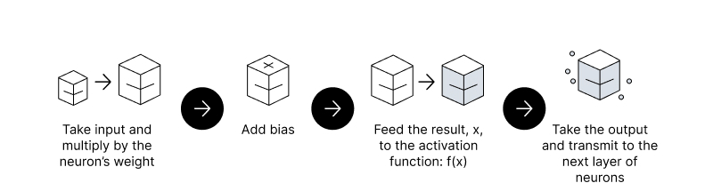
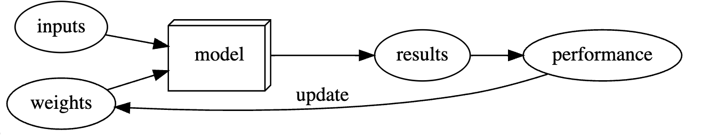
Feedforward vs. Backpropagation
💡 Feedforward Propagation - the flow of information occurs in the forward direction. The input is used to calculate some intermediate function in the hidden layer, which is then used to calculate an output.
💡 Back Propagation - Backpropagation is just a way of propagating the total loss back into the neural network to know how much of the loss every node is responsible for, and subsequently updating the weights in a way that minimizes the loss by giving the nodes with higher error rates lower weights, and vice versa.

Slide 7
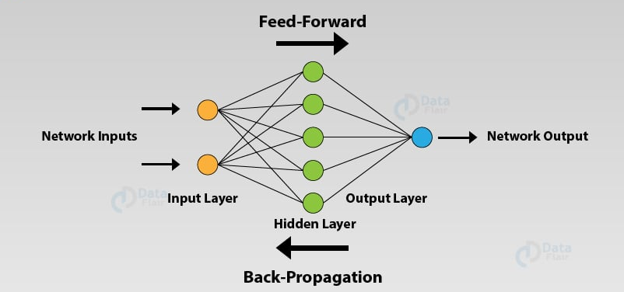

Slide 8
Activation Function?
What is Activation Function?
It’s a function, which is used to get the output of node. It is also known as Transfer Function.
Why we use Activation functions with Neural Networks?
It is used to determine the output of neural network like yes or no. It maps the resulting values in between 0 to 1 or -1 to 1 etc. (depending upon the function).

Slide 9
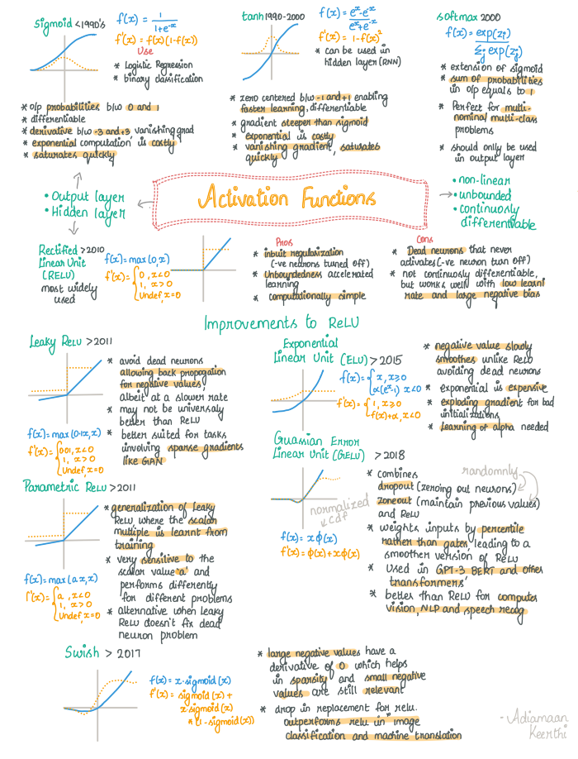
Activation Function

Slide 10
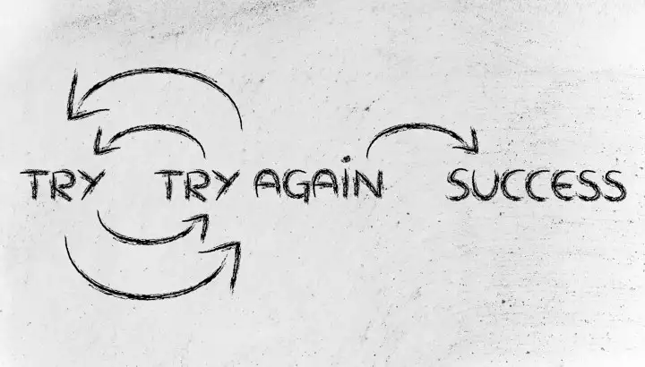
Loss Function
That is the winning motto of life. Unsurprisingly, it is the same motto with which all machine learning algorithms function too. The model tries to learn from the behavior and inherent characteristics of the data, it is provided with. It then applies these learned characteristics to unseen but similar (test) data and measures its performance. It continually repeats this process until it achieves a suitably high accuracy or low error rate — succeeds.
Measuring the model performance is at the heart of any machine learning algorithm, and this is done by the use of loss functions.
Choosing the right loss function can help your model learn better, and choosing the wrong loss function might lead to your model not learning anything of significance.

Slide 11
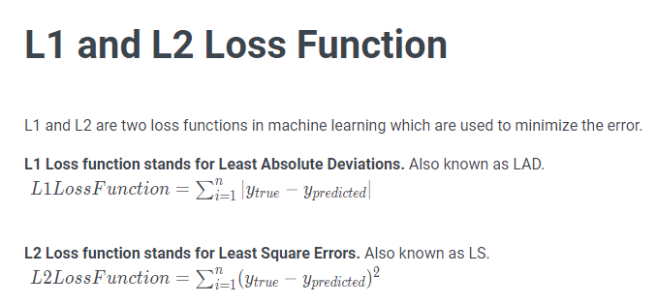
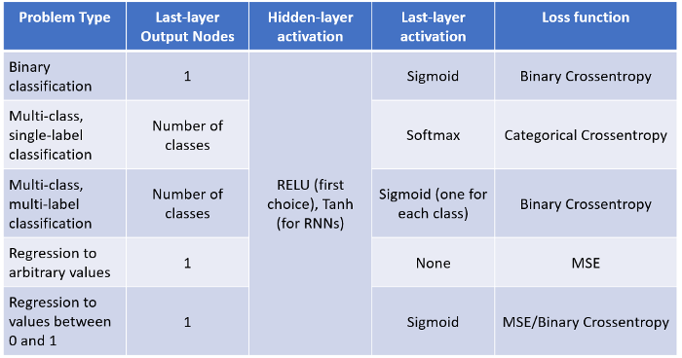
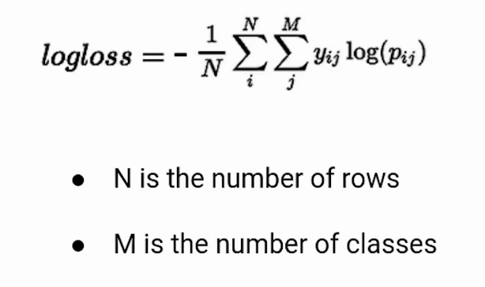

Slide 12
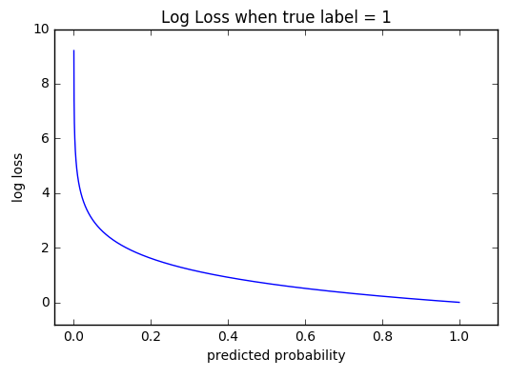
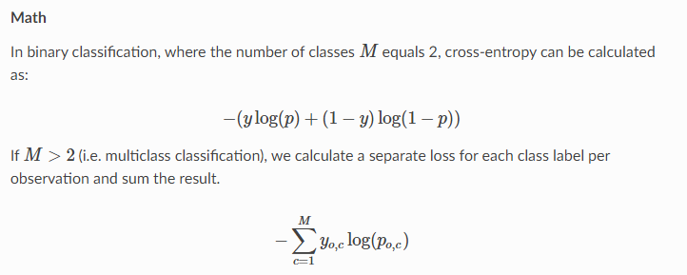
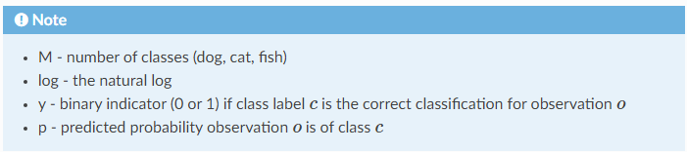
Cross-Entropy
Cross-entropy loss, or log loss, measures the performance of a classification model whose output is a probability value between 0 and 1. Cross-entropy loss increases as the predicted probability diverges from the actual label. So predicting a probability of .012 when the actual observation label is 1 would be bad and result in a high loss value. A perfect model would have a log loss of 0.
The graph above shows the range of possible loss values given a true observation (isDog = 1). As the predicted probability approaches 1, log loss slowly decreases. As the predicted probability decreases, however, the log loss increases rapidly. Log loss penalizes both types of errors, but especially those predictions that are confident and wrong!
Cross-entropy and log loss are slightly different depending on context, but in machine learning when calculating error rates between 0 and 1 they resolve to the same thing.

Slide 13

The use of negative logs on probabilities, which is known as the cross-entropy, where a high number means bad models and a low number means a good model.

Slide 14
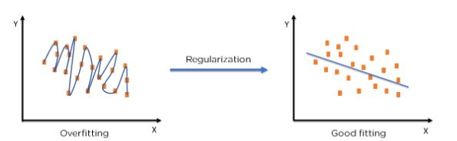
Regularization
Regularization refers to techniques that are used to calibrate machine learning models in order to minimize the adjusted loss function and prevent overfitting or underfitting.

Slide 15

The commonly used regularization techniques are :
L1 regularization
L2 regularization
Dropout regularization
This article focus on L1 and L2 regularization.
A regression model which uses L1 Regularization technique is called LASSO(Least Absolute Shrinkage and Selection Operator) regression. A regression model that uses L2 regularization technique is called Ridge regression. Lasso Regression adds “absolute value of magnitude” of coefficient as penalty term to the loss function(L).
Ridge regression adds “squared magnitude” of coefficient as penalty term to the loss function(L).
that during Regularization the output function(y^) does not change. The change is only in the loss function

Slide 16



Slide 17
